Slide 1
Deep CANALs: A Deep Learning Approach to Refining the Canalization Theory of Psychopathology
Juliani, Safron and Kanai, 2023

Slide 2
Psychedelics
May effectively treat a variety of psychopathologies.
Aren’t for everyone, or every disorder.
How could new psychiatric models help?

Slide 3
Beliefs
The term “beliefs” refers to Bayesian priors and the models than maintain them.
Notes:
Throughout the presentation, you’ll see the word beliefs. This could be taken to mean beliefs in the traditional sense, or any cognitive prediction generated by the brain. We will also refer to “belief landscapes” which can be understood as the neural models that maintain and update those predictions.

Slide 4
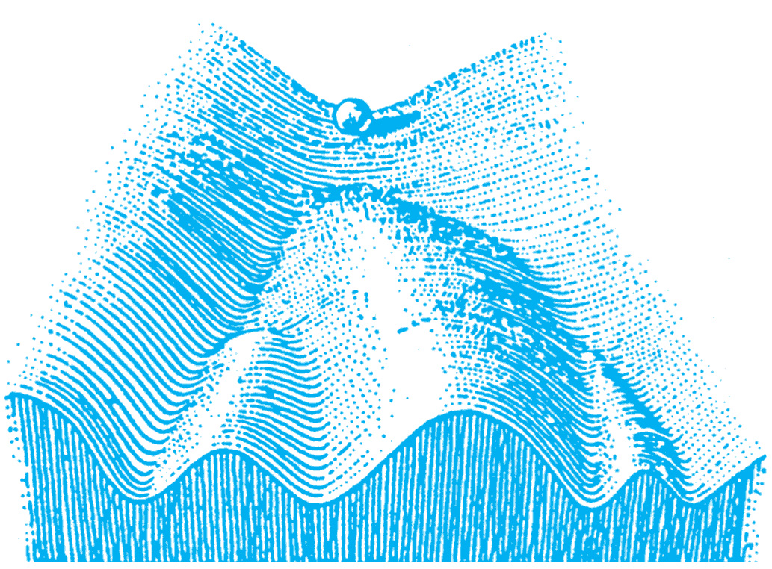
CANAL Model of Psychopathology
Canalization: The development of overly precise or rigid beliefs about the state of the world.
Rigid beliefs can act as sticky attractors, becoming engaged in inappropriate and maladaptive contexts.
Carhart-Harris 2023
Notes:
One-dimensional model of psychopathology.
Our general theory states that: cognitive and behavioral phenotypes that are regarded as psychopathological, are canalized features of mind, brain, or behavior that have come to dominate an individual’s psychological state space. We propose that the canalized features develop as responses to adversity, distress, and dysphoria, and endure despite, rather than because of, evidence.
The model considers psychopathologies as acquired, and likely rooted in adaptive strategy that by becoming entrenched (canalized) and therefore maladaptive to changing conditions.
The construct of ‘canalization’ was introduced in biology in 1942 by British evolutionary scientist, Conrad Hal Waddington, in the context of phenotypic variation in development, where it refers to phenotypic stabilization

Slide 5
CANAL Model of Psychopathology
Psychedelic interventions may “anneal” canalized beliefs.
Carhart-Harris 2023
Notes:
In this presentation, “beliefs” refers to predictions and the models that produce them.
In Bayesian terms, canalization can be described as when the precision (or confidence) of prior beliefs (a prediction or model) becomes inappropriately high, leading to a failure of adaptability and the perpetuation of cognitive or behavioral entrenchment.

Slide 6
HPP
Hierarchical Predictive Processing
Sequence of models predict the activity of hierarchically lower models.
Error signals from lower-level models propagate upward.
Keller 2018
Notes:
The hierarchical nature of these generative models is manifest in the fact that ones
at lower levels of the hierarchy make predictions which are more concrete, and at smaller spatiotemporal
scales. In contrast, further up the hierarchy the models make predictions which are more abstract and on
larger spatiotemporal scales.

Slide 7
HPP + Psychedelics
If high level models are unable to predict beliefs at lower levels, they can’t suppress them.
Error signals continue to propagate up.
Keller 2018
Notes:
Psychedelics increase the magnitude of prediction errors and he inability of the brain’s high-level generative models to predict the beliefs at lower levels corresponds
to an inability to suppress those beliefs, with incoming evidence from lower-level beliefs serving to more
greatly impact the updating of beliefs at higher levels.
Thoughts that maybe have been only perceptible as a feeling, but not articulated as a thought fully, may propagate more freely up the hierarchy.

Slide 8
Free Energy
Biological systems resist the natural tendency toward disorder.
By minimizing prediction error, brains minimize free energy.
Friston 2013
Notes:
Free energy can be considered in terms of entropy. A circuit with more unaccounted for prediction error could be considered in a higher state of entropy, with
The free energy principle is a theory from neuroscience and theoretical biology that describes how any biological system, including the brain, resists a natural tendency to disorder. Proposed by neuroscientist and psychiatrist Karl Friston, the principle suggests that all the elements of the brain, from molecular structures to neural networks, strive to minimize their free energy, which in this context is a measure of surprise or prediction error.

Slide 9
Free Energy
Psychopathologies can arise from cognitive and behavioral strategies for minimizing uncertainty.
Psychedelics amplify prediction error.
Friston 2013
Notes:
Free energy can be considered in terms of entropy. A circuit with more unaccounted for prediction error could be considered in a higher state of entropy, with
The free energy principle is a theory from neuroscience and theoretical biology that describes how any biological system, including the brain, resists a natural tendency to disorder. Proposed by neuroscientist and psychiatrist Karl Friston, the principle suggests that all the elements of the brain, from molecular structures to neural networks, strive to minimize their free energy, which in this context is a measure of surprise or prediction error.

Slide 10
Neuroanatomy
5-HT2ARs are widely distributed in cortex.
Heavily concentrated in layer V
Weber 2010
Notes:
Layer V of the neocortex plays a crucial role in transmitting information both within the cortex and to subcortical structures, contributing to a wide range of brain function
Output to Subcortical Areas: One of the main roles of layer V is to send outputs to subcortical areas. The pyramidal neurons in this layer have long axons that reach subcortical structures such as the brainstem and spinal cord. They also project to other areas such as the basal ganglia and the thalamus.
Motor Control: Layer V is crucial in motor control. The primary motor cortex contains layer V pyramidal neurons, known as Betz cells, which send long axons down the spinal cord to directly innervate motor neurons and control voluntary movement.
Involvement in Information Processing: The neurons in layer V are also involved in intra-cortical information processing. This is due to their connections with other cortical layers and with different cortical areas, which facilitates the integration and processing of information.
Role in Cognitive Functions: Layer V is involved in various cognitive functions. Given the 5-HT2A receptors' high concentration in this layer, it is implicated in functions modulated by these receptors, such as mood, cognition, and perception.
Role in Cortico-Cortical Communication: Layer V also contains neurons that project to other areas of the cortex, facilitating communication between different cortical regions.

Slide 11
Thalamic Gating Hypothesis
Bedford 2023
Notes:
Thalamic gating Hypothesis. Connectivity from and to thalamus, lsd – placebo. Lsd shows increased connectivity both to and from thalamus.

Slide 12
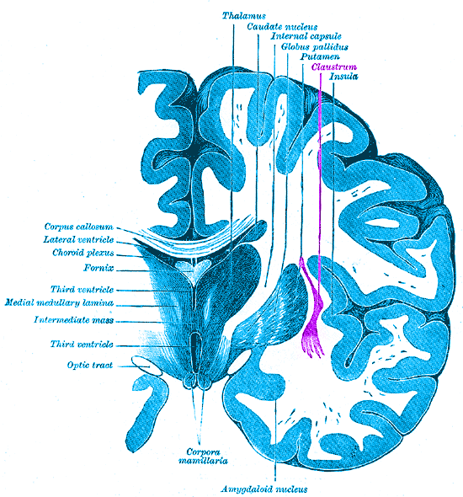
Claustrum
One the brain’s most densely connected regions.
And dense in 5-HT2ARs.
Doss 2022
Notes:
It is considered to be the most densely connected structure in the brain, allowing for integration of various cortical inputs (e.g., colour, sound and touch) into one experience rather than singular events.
Difficult to study because it’s small and tucked in.
One of the proposed functions of the claustrum is to differentiate between relevant and irrelevant information so that the latter can be ignored.^{[4][8][9]} Cortical components of consciousness include the fronto-parietal cortex, cingulate and precuneus. Due to the claustrum's widespread connectivity to these areas, it is suggested that it may play a role in both attention and consciousness

Slide 13
REBUS Model
Carhart-Harris 2019
Notes:
‘RElaxed Beliefs Under pSychedelics,’ (REBUS) suggests that psychedelics act therapeutically by relaxing the strength of maladaptive high-level beliefs encoded in
the brain.
The main tenet of REBUS is that psychedelics decrease the precision-weighting (i.e., inverse variance or ‘confidence’) of internal predictive models (i.e., ‘beliefs’ or ‘priors’) encoded in brain activity. More specifically, REBUS proposes that precision-weighting on priors is decreased under psychedelics; effectively flattening the free-energy landscape.

Slide 14
Artificial Neural Networks
The authors take inspiration from ANNs to propose a two-factor model of canalization.
They ask if a more accurate model would disambiguate between overfitting and plasticity loss.
Notes:
Could pathologies in neural networks correspond to pathologies in brains?

Slide 15
Notes:
Figure 2: A. In an RNN performing free-energy minimization, there are two different underlying optimization
landscapes, one corresponding to the activation pattern (h), and another corresponding to the synaptic
weight values (θ). B. Different locations in a belief landscape will correspond to representing different
beliefs, for example a positive or negative body image. C. The actualization of these beliefs takes place
through the neural activity patterns, which are supported by the inference optimization landscape. D. The
topology of the inference landscape is a function of the synaptic weight values which are defined by a
learning optimization landscape.

Slide 16
Notes:
Inference relates to stability of belief landscape, and in this schematic illustrates the idea that a psychedelic experience might promote canalization of new beliefs, as a result of experiencing them strongly during the trip. The post acute belief landscape may be softened in some respects, but also complicated by new realizations and memories.
On the other hand, learning relates to plasticity of connections within a landscape, and in this sense we would expect to see an effect more similar to the original rebus model. Weights between neurons in the neural activation landscape are relaxed, which would produce a more “open minded” but potentially overplastic model

Slide 17
Canalization is not necessarily bad
Healthy people may hold low-entropy, highly-canalized beliefs.
Some psychopathologies may involve undercanalization.
In the two-factor model, canalization may be unbalanced.
Notes:
In the context of optimizing a deep neural network, canalization corresponds to different pathologies
along two separate dimensions. Along the Type A dimension, this includes underfitting and overfitting.
B. Along the Type B dimension, this includes catastrophic forgetting and plasticity loss. Along each
dimension, optimal adaptability corresponds to maintaining a balance between extremes.
Traditionally, neural networks are trained on a batch of data and learn to identify patterns or features in that data. Once the training is completed, if we start training the same network on new data, it tends to completely forget the patterns it learned from the first batch. This phenomenon is what is referred to as catastrophic forgetting.
Various methods have been proposed to mitigate catastrophic forgetting. For example, one approach is to interleave new and old data during training, so the network doesn't completely focus on the new data. Another approach, known as regularization, involves adding a penalty to the loss function if the weights change too much from their original values.

Slide 18
Stability & Plasticity
Notes:
In the context of optimizing a deep neural network, canalization corresponds to different pathologies
along two separate dimensions. Along the Type A dimension, this includes underfitting and overfitting.
B. Along the Type B dimension, this includes catastrophic forgetting and plasticity loss. Along each
dimension, optimal adaptability corresponds to maintaining a balance between extremes.
Traditionally, neural networks are trained on a batch of data and learn to identify patterns or features in that data. Once the training is completed, if we start training the same network on new data, it tends to completely forget the patterns it learned from the first batch. This phenomenon is what is referred to as catastrophic forgetting.
Various methods have been proposed to mitigate catastrophic forgetting. For example, one approach is to interleave new and old data during training, so the network doesn't completely focus on the new data. Another approach, known as regularization, involves adding a penalty to the loss function if the weights change too much from their original values.

Slide 19
Notes:
Representative psychopathologies associated with either extreme of canalization along each of the two optimization landscapes underlying belief inference. Color corresponds to potential efficacy of psychedelic therapy to address associated pathologies.

Slide 20
The Betterment of Well People
What does a healthy mind have to lose or gain from psychedelics?
How much entropy is ideal?
What is mental wellness?
Notes:
I personally liken mental health to physical health, in that it is possible to be quite healthy or quite disordered, but that it is always in flux and requires attention and maintenance.

Slide 21
Questions
Do the inference and learning factors correspond to the acute and post-acute effects of psychedelics?
What about non-psychedelic neuroplastogens?
Notes:
I personally liken mental health to physical health, in that it is possible to be quite healthy or quite disordered, but that it is always in flux and requires attention and maintenance.

Slide 22
Questions
How might cognitive therapy fit in with the CANAL model?
Are psychedelics necessarily an adventurous undertaking?
Is risk necessary for adventure?
Is risk necessary for therapy?
Notes:
I personally liken mental health to physical health, in that it is possible to be quite healthy or quite disordered, but that it is always in flux and requires attention and maintenance.

